Slide 1
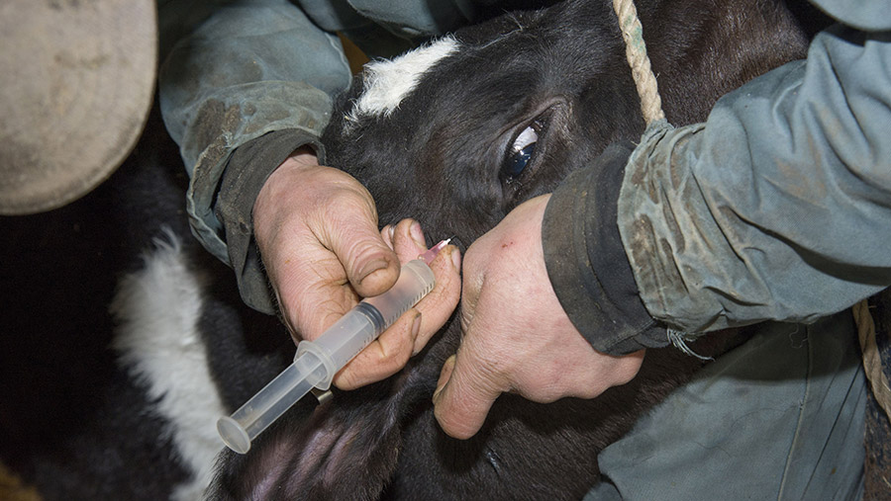
Local Anesthetic and Analgesic Techniques

Slide 2
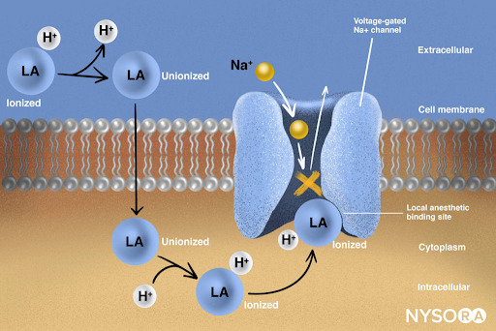
Local anesthetics are a group of chemically related compounds that reversibly bind sodium channels and block impulse conduction in nerve fibers.
Local anesthetics produce a transient and reversible loss of sensation (analgesia) in a circumscribed region of the body without loss of consciousness

Slide 3
Purpose of local anesthesia
It is to be performed in a conscious patient and the pain associated with trauma and inflammation.
avoiding general anesthesia or reducing the amount of required general anesthetics.
Sustained analgesia into the recovery period

Slide 4
Classification of loco‐regional anesthesia
Topical or surface anesthesia
Used at the site of a superficial injury.
Unfortunately, most local anesthetics are not readily absorbed across the skin surface
mixtures of local anesthetics comprised of 2.5% lidocaine and 2.5% prilocaine formulated as a cream
These creams are indicated for dermal anesthesia and have been reported to be useful for:
1. preventing pain associated with percutaneous intravenous catheter placement,
2. blood sampling,
3. superficial skin closure in people.
Local anesthetic efficacy is achieved after approximately 60 min and lasts for up to 2 h

Slide 5
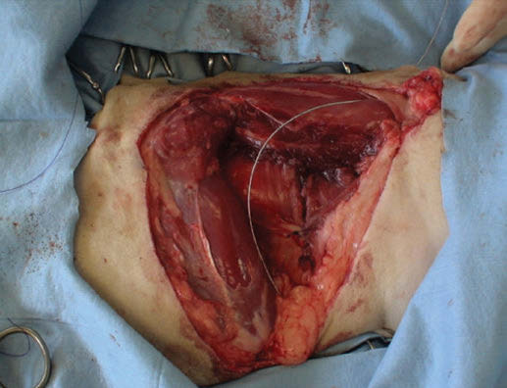
2. Infiltration anesthesia
Infiltration anesthesia involves the injection of local anesthetic solution into and around the planned surgical field
Development and use of wound infusion catheters have taken this technique a step further, allowing the continuous or intermittent delivery of local anesthetics into tissues surrounding surgical wounds without the need for repeated needle penetration for injection of analgesic drugs

Slide 6
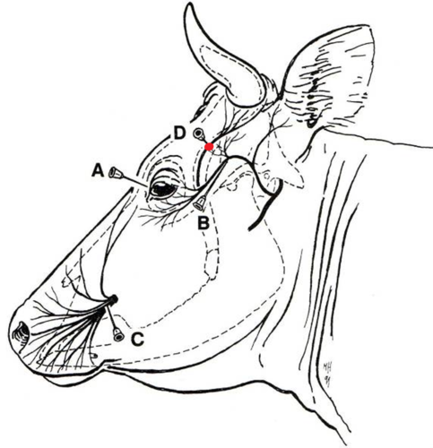
3. Regional or nerve (plexus) block anesthesia
Regional anesthesia refers to the injection of a local anesthetic solution adjacent to a peripheral nerve

Slide 7
4. Neuraxial anesthesia
The administration of agents with anesthetic and/or analgesic properties via epidural or spinal routes can be effective at relieving pain
Epidural anesthesia refers to the administration of drugs (usually a local anesthetic solution) into the epidural space, whereas the administration of a drug into the subarachnoid space is known as spinal, subarachnoid, or intrathecal anesthesia. Opioids and other classes of analgesic agents can be administered by this route

Slide 8
5. Intra‐articular analgesia
Local anesthetics, opioids, steroids, and other adjuvants are commonly administered into joints as a means of providing intra‐articular analgesia.
Intra‐articular injection of local anesthetic provides analgesia for intra‐articular structures only, and will not prevent pain arising from extra‐articular structures such as subchondral bone, extra‐articular soft tissue, or skin.

Slide 9
Intra‐articular analgesia
Recently, attention has been drawn to the possible toxic effects of local anesthetics on chondrocytes.
Based on clinical experience, a single injection of low‐concentration bupivacaine solution appears to be safe, and the chondrotoxic effects of a single intra‐articular injection of 0.5% bupivacaine appear minor (but statistically significant) and are unlikely to be detected clinically,

Slide 10
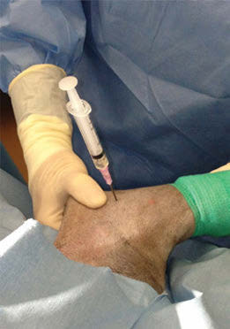
A needle has been placed into the elbow joint on the medial aspect of the left thoracic limb of a dog that is positioned in dorsal recumbency.
A needle is being placed into the right scapula humeral joint of a dog that is positioned in the left lateral recumbency.

Slide 11
6. Intravenous regional anesthesia (IVRA)
Also referred to as a ‘Bier block,’
IVRA involves administration of a local anesthetic into a peripheral vein, where it is distributed to the tissues served by the local venous drainage, and provides surgical anesthesia for up to 90 min.
Prior to drug administration, the limb is elevated and wrapped in a tight bandage. A tourniquet is then applied proximal to the injection site, and the local anesthetic is injected into a vein.

Slide 12
6. Intravenous regional anesthesia (IVRA)
The tissues distal to the tourniquet will be desensitized. Care must be taken so that limb ischemia time is kept at a minimum to avoid tissue damage.
Additionally, early release of the tourniquet may result in transient increases in local anesthetic plasma concentrations, which can result in central nervous and myocardial system toxicities.

Slide 13
7. Thoracic blocks
Selective intercostal nerve block and infusion of local anesthetics into the interpleural space are the primary means of providing analgesia for thoracic procedures in dogs and

Slide 14
The common Types of blocks
Nerve blocks: If we know where the nerve is, we can just put local anesthetic near the nerve. Eg dehorning blocks and paravertebral blocks
Line blocks: Local anesthetic is injected in the line of the planned incision. it is the easiest to control
Field blocks: The nerves to a region are blocked using specific types of line blocks. An L block is used in the flank to block the regional paravertebral nerves.
Ring blocks: A specific type of field block. The entire limb is encircled with subcutaneous local anesthetic to reach any and all nerves

Slide 15
Line block
A line block is an injection of subcutaneous lidocaine along the site of the incision
The block can be easier on the animal if a longer needle is used and is inserted through the site of the last injection. This minimizes the number of pokes in unblocked skin.
For flank incisions, it is important to also place lidocaine deeper in the muscle layers.
The main disadvantage of a line block is distortion of the surgery field

Slide 16
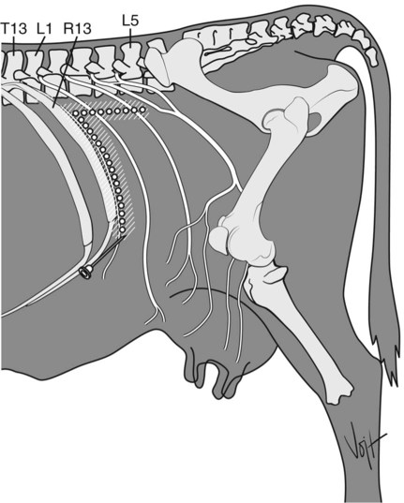
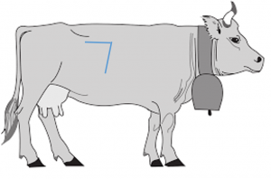
Inverted L block
block is similar to the line block but is used to block the nerves as they come down the flank and avoids lidocaine directly in the surgery field.
The lidocaine is injected in two long lines – one just behind the last rib and one below the transverse processes of the vertebrae. The injection must be deep enough to get the deeper nerves and typically does not block the peritoneum.

Slide 17
Proximal paravertebral block
For this block, the spinal nerves T13, L1 and L2 are blocked as directly as possible as they exit the spinal cord. This creates a more effective block. When the block is working, the cow will bend toward the opposite side as muscles are relaxed.
At each site, ~20 ml of lidocaine is injected. Needles are inserted above the transverse processes T13, L1 and L2 and walked off the dorsal margin of each bone. A long needle is used to block the nerve branches both above and below the fascia.
This block can be challenging in very large beef breeds due to difficulty palpating landmarks.

Slide 18
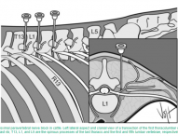

Slide 19
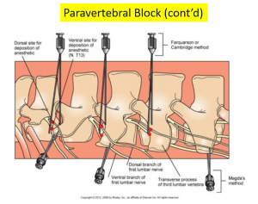
Distal paravertebral block
This block is also aimed at spinal nerves T13, L1 and L2 but is coming at them from a more distal position.
As the nerves traverse caudally, the injection sites are at the tips of L1, L2 and L4. At each site, 10-20 ml of lidocaine is injected.

Slide 21
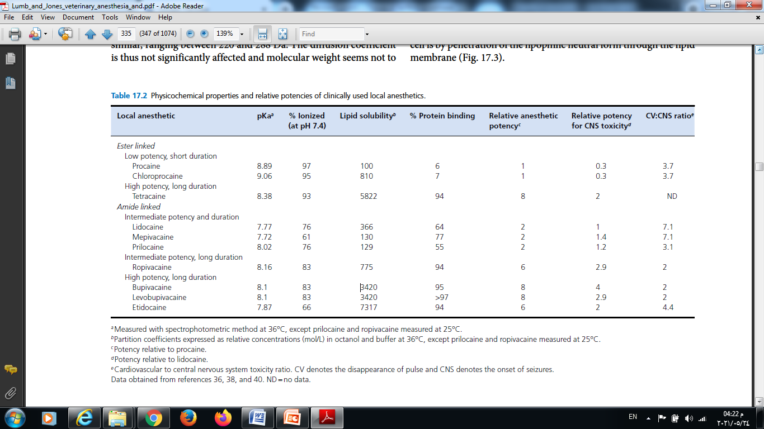

Slide 22
The ideal of local anesthetic drug
Non irritant
Non allergic reaction
No systemic toxicity
Rapid onset of action
Sufficient duration of action
Potent
Stable in solutions
Not interfering with healing of tissue
Have a vasoconstrictor action
Not expensive

